Slide 1
“The Act Heard ‘Round the World”
Mark 14:1-11

Slide 2
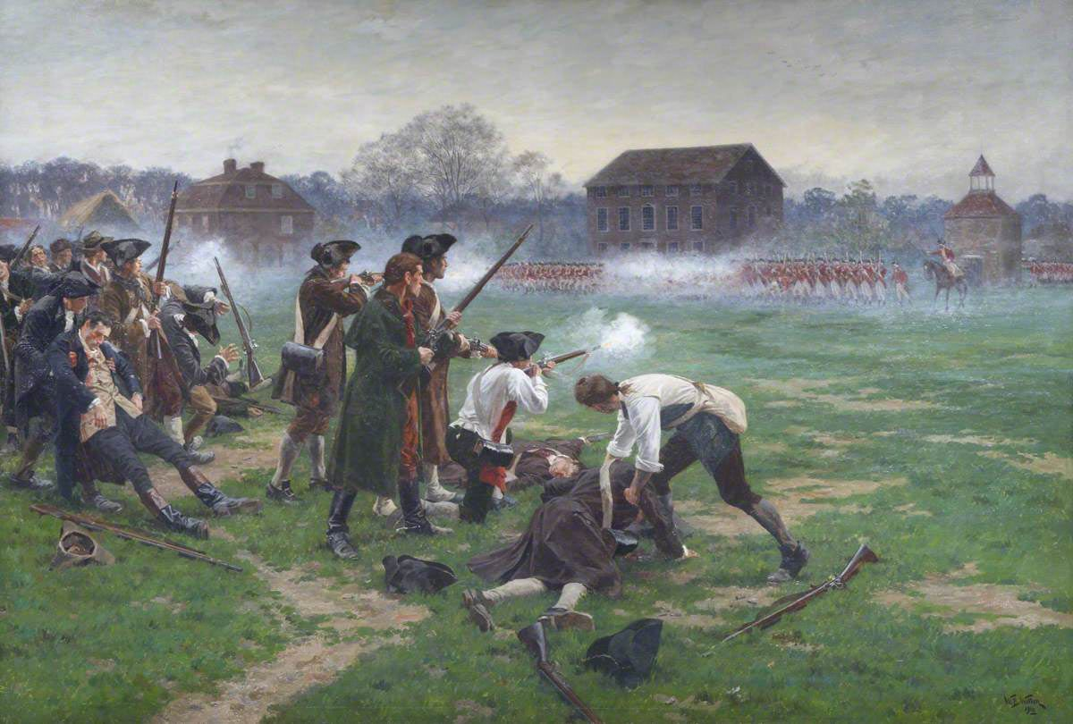

Slide 3
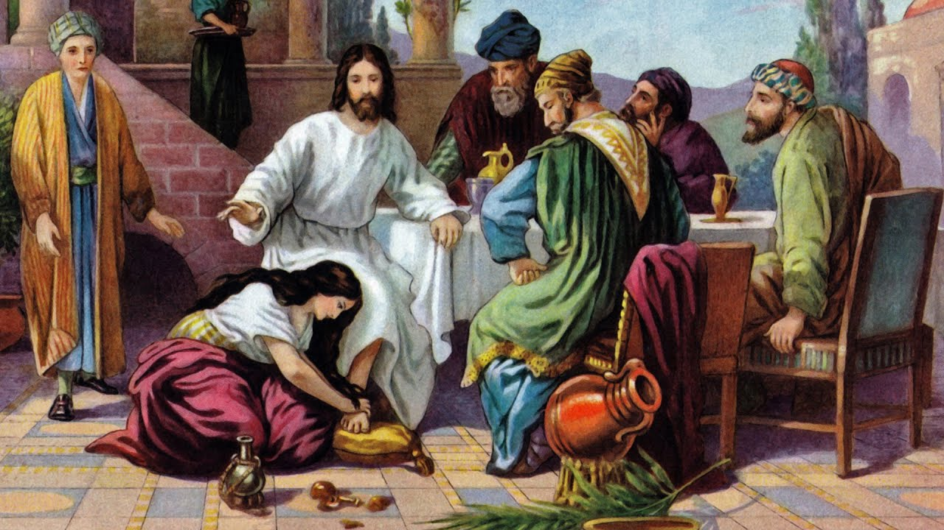

Slide 4
¹ It was now two days before the Passover and the Feast of Unleavened Bread. And the chief priests and the scribes were seeking how to arrest him by stealth and kill him,
² for they said, "Not during the feast, lest there be an uproar from the people." (14:1-2)
.
.
.
¹⁰ Then Judas Iscariot, who was one of the twelve, went to the chief priests in order to betray him to them.
¹¹ And when they heard it, they were glad and promised to give him money. And he sought an opportunity to betray him. (14:10-11)

Slide 5
Mary of Bethany (Luke 10:38-39)
³⁸ Now as they went on their way, Jesus entered a village. And a woman named Martha welcomed him into her house.
³⁹ And she had a sister called Mary, who sat at the Lord's feet and listened to his teaching.

Slide 6
Mary of Bethany (John 11:31-32)
³¹ When the Jews who were with her in the house, consoling her, saw Mary rise quickly and go out, they followed her, supposing that she was going to the tomb to weep there.
³² Now when Mary came to where Jesus was and saw him, she fell at his feet, saying to him, "Lord, if you had been here, my brother would not have died."

Slide 7
Mary of Bethany (John 12:3)
³ Mary therefore took a pound of expensive ointment made from pure nard, and anointed the feet of Jesus and wiped his feet with her hair. The house was filled with the fragrance of the perfume.

Slide 8
I. An Act of Love (v. 3)
³ And while he was at Bethany in the house of Simon the leper, as he was reclining at table, a woman came with an alabaster flask of ointment of pure nard, very costly, and she broke the flask and poured it over his head.

Slide 9
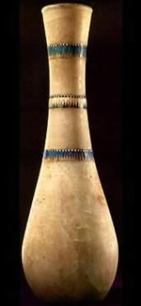
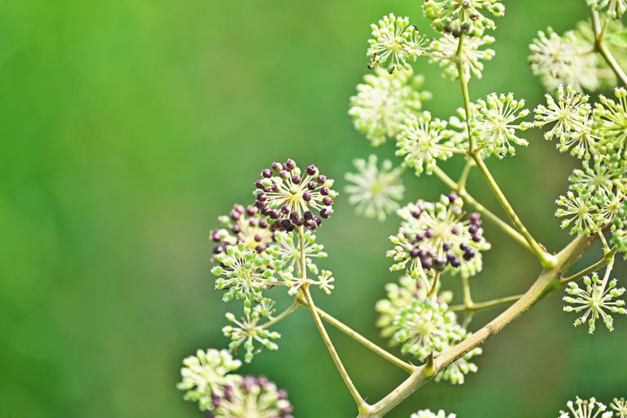

Slide 10
“You must give what will cost you something. This, then, is not just giving what you can live without but what you can't live without or don't want to live without, something you really like. Then your gift becomes a sacrifice, which will have value before God. Any sacrifice is useful if it is done out of love. This giving until it hurts - this sacrifice - is what I call love in action.”
– Mother Theresa

Slide 11
John 13:34-35
³⁴ A new commandment I give to you, that you love one another: just as I have loved you, you also are to love one another.
³⁵ By this all people will know that you are my disciples, if you have love for one another."

Slide 12
II. An Appropriate Lesson (vv. 4-8)
⁴ There were some who said to themselves indignantly, "Why was the ointment wasted like that?
⁵ For this ointment could have been sold for more than three hundred denarii and given to the poor." And they scolded her.
⁶ But Jesus said, "Leave her alone. Why do you trouble her? She has done a beautiful thing to me.
⁷ For you always have the poor with you, and whenever you want, you can do good for them. But you will not always have me.
⁸ She has done what she could; she has anointed my body beforehand for burial.

Slide 13
III. An Ageless Legacy (v. 9)
⁹ And truly, I say to you, wherever the gospel is proclaimed in the whole world, what she has done will be told in memory of her.”

Slide 14
Only One Life, ‘Twill Soon Be Past – C.T. Studd
Oh let my love with fervor burn,
And from the world now let me turn;
Living for Thee, and Thee alone,
Bringing Thee pleasure on Thy throne;
Only one life, “twill soon be past,
Only what’s done for Christ will last.
Only one life, yes only one,
Now let me say,”Thy will be done”;
And when at last I’ll hear the call,
I know I’ll say “twas worth it all”;
Only one life,’twill soon be past,
Only what’s done for Christ will last. ”

